Slide 1


cc
Water Level Indicator

Slide 2

Instructor :
DR. MD. KABIRUZZAMAN
ASSISTANT PROFESSOR
American International University Bangladesh
Name | ID
EMON BISWAS | 23-50174-1
UMARA RASHID | 23-51327-1
SADIK SADMAN | 23-51300-1
MD. OWAFEEUZZAMAN PATWARY | 22-49885-3
MD. ABU RABBIUL RIYAD | 22-49864-3

Slide 3
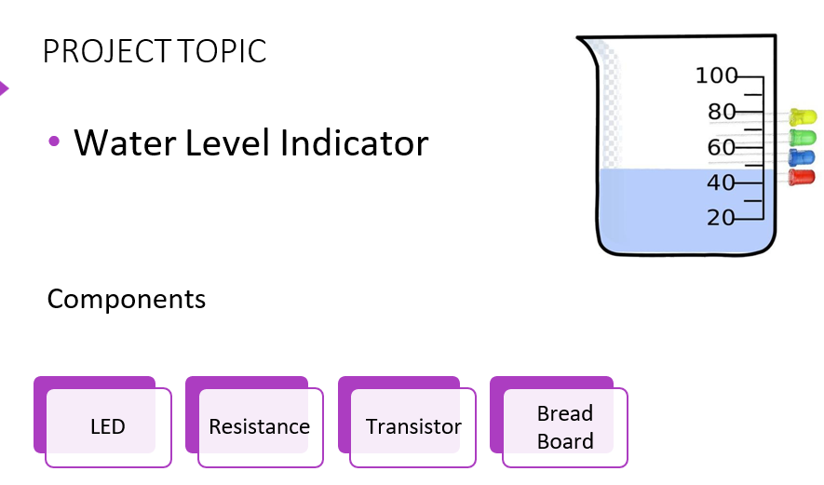

Slide 4
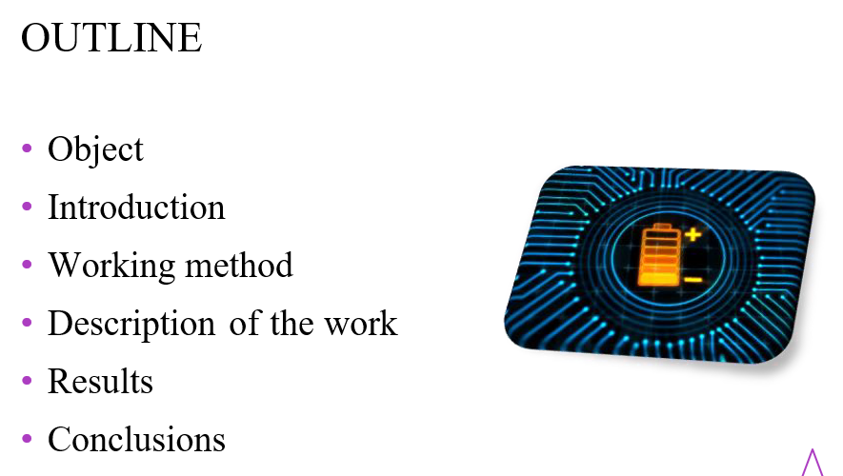

Slide 5
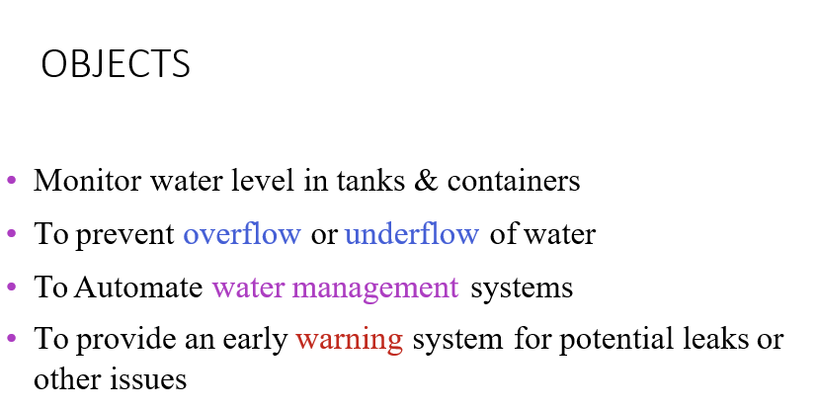

Slide 6
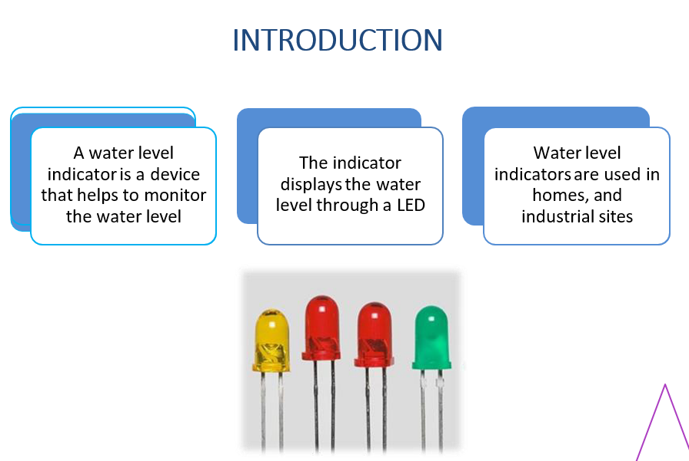

Slide 7
cc
WORKING
METHOD

Slide 8
WORKING METHOD
WORKING METHOD
Set up a circuit with a 9V battery, transistor, LED, and two electrodes: one sense electrode and one glass reference electrode.
Place the sense electrode at the bottom of the glass and the reference electrode above it.
As water comes in contact with the sense electrode, it establishes a conductive path between the sense electrode and the glass reference electrode…

Slide 9
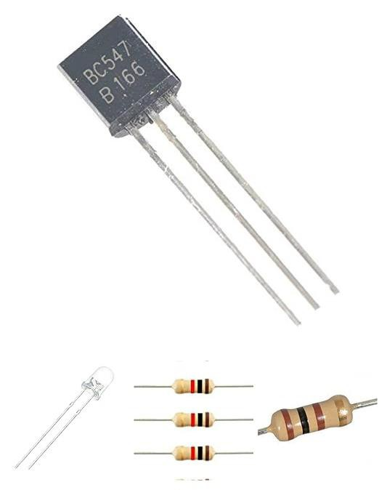
WORKING METHOD
WORKING METHOD
This conducts the transistors, which in turn lights up the
LED, indicating the water level.
The water level can be determined by the height of the last
dry electrode

Slide 10
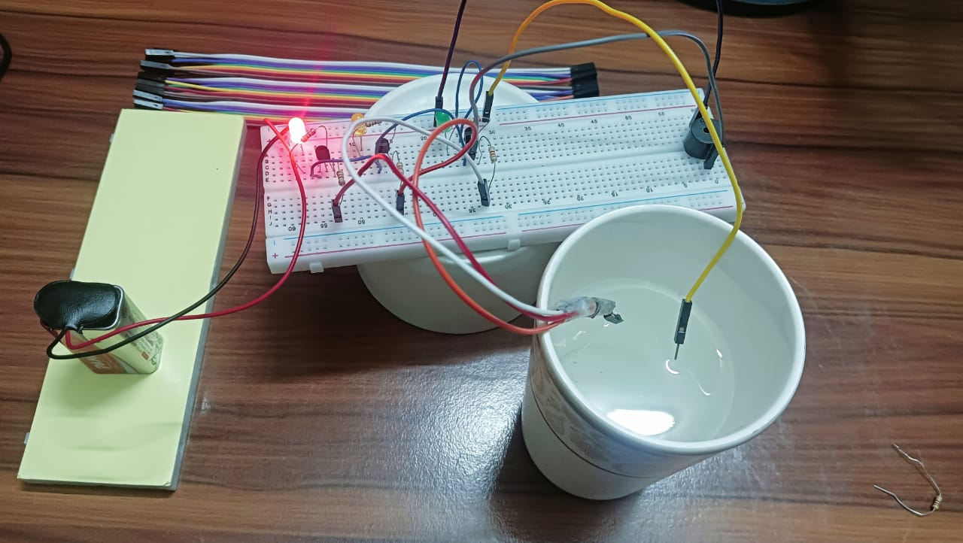
FIRST LEVEL (1) : 1 LED ON

Slide 11
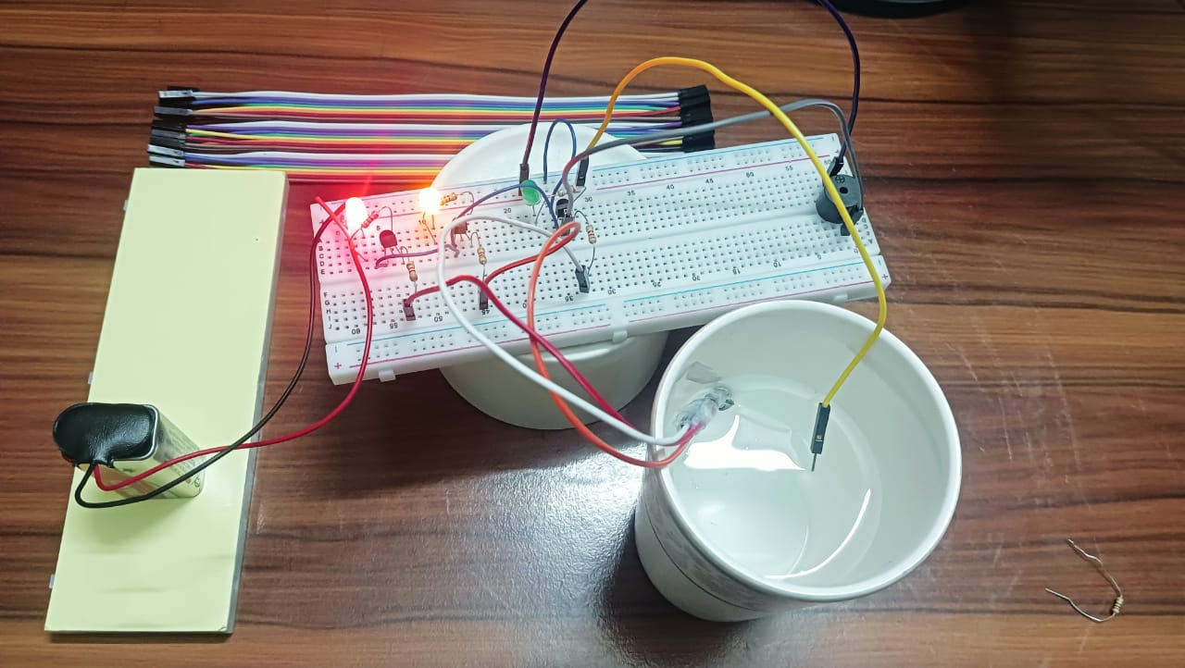
SECOND LEVEL (2) : 2 LEDS ON

Slide 12
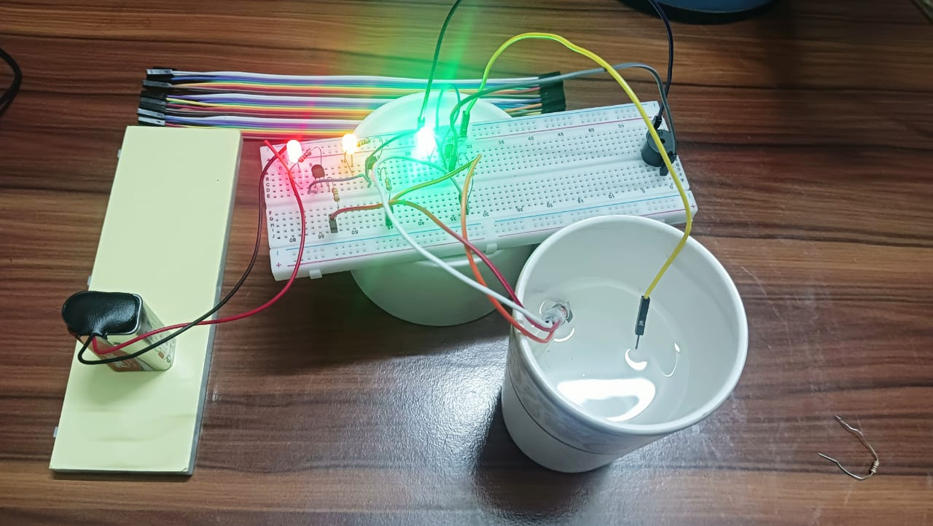
THIRD LEVEL (2) : 3 LEDS ON

Slide 13
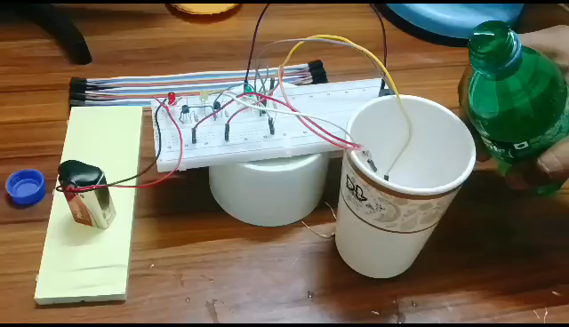

Slide 14
The project involves the use of simple components such as transistors, LEDs, resistors, and wires
CONCLUSION
The water level indicator is a useful
device for monitoring the water level
The project involves the use of simple
componentssuch as transistors, LEDs,
resistors, and wires
The circuit can be easily assembled
and tested using a breadboard
The water level indicator is a low-cost
and energy- efficient solution

